Slide 1

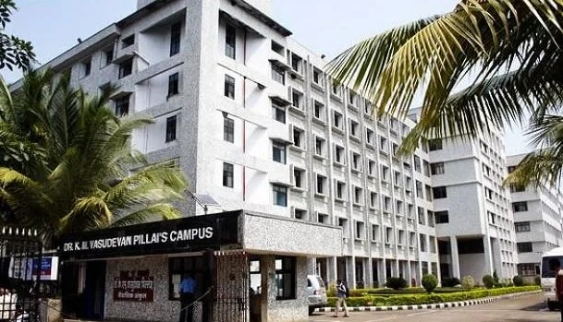
Mahatma Education Society’s Pillai College Of Engineering, Panvel Department Of Computer Engineering
Mini Project Presentation On
Café Management System
Under the guidance of
Prof.Sangeeta Selvan.
Group Members
Sakshi Barde(CE-B 304)
Tanaya Gharge(CE-B 315)
Ashutosh khedkar(CE-B 323)
Utsav Khairnar(CE-B 321)

Slide 2
OVERVIEW
1. INTRODUCTION
2. PROPOSED SYSTEM
3. TECHNOLOGY USED
4. MODULE USED
5. MOTIVATION
6. ABSTRACT VIEW
7. LIMITATIONS OF THE SYSTEM
8. FLOWCHART
9. WORKING
10. REQUIREMENTS
11.RESULT
12. FUTURE WORKS
13. REFERENCES
14. CONCLUSION

Slide 3
INTRODUCTION
The title of the project is café management system
The project will help to handle the information accurately and can add and manage data in the system
Using the computerize method the user can handle sales information effectively rather than manual system

Slide 4
PROPOSED SYSTEM
First the user will see a login page where he has to register first and then login through user Id.
Then he will be directed the main page where he will see three buttons that are customer , order, logout.
In customer window the user will be able to enter the customer details.
In order window the user will be able to place the customers order and then provide them the bill
In logout window on entering it the user will be directed towards the login page again.

Slide 5
TECHNOLOGY USED
PYTHON: Python is a general-purpose,versatile,and powerful programming language. It’s a great first language because Python code is concise and easy to read. Whatever you want to do, python can do it. From web development to machine learning to data science, Python is the language for you.
Python is dynamically typed and garbage-collected. It supports multiple programming paradigms, including structured (particularly procedural), object-oriented and functional programming. It is often described as a "batteries included" language due to its comprehensive standard library.

Slide 6
TECHNOLOGY USED
MYSQL:is an open-source relational database management system "SQL", the acronym for Structured Query Language. A relational database organizes data into one or more data tables in which data may be related to each other; these relations help structure the data. SQL is a language that programmers use to create, modify and extract data from the relational database, as well as control user access to the database. In addition to relational databases and SQL, an RDBMS like MySQL works with an operating system to implement a relational database in a computer's storage system, manages users, allows for network access and facilitates testing database integrity and creation of backups. MySQL is free and open-source software under the terms of the GNU General Public License, and is also available under a variety of proprietary licenses.

Slide 7
MODULES USED
Tkinter: The reason to use tkinter for creating GUI is that it is the fastest and easiest way. Creating a GUI using tkinter is an easy task. We had use various function from tkinter module like Entry, filedialog, image, messagebox.
Time: The Python time module provides many ways of representing time in code, such as objects, numbers, and strings. It also provides functionality other than representing time, like waiting during code execution and measuring the efficiency of your code.
Random: Python Random module is an in-built module of Python that is used to generate random numbers in Python. These are pseudo-random numbers means they are not truly random. This module can be used to perform random actions such as generating random numbers, printing random a value for a list or string, etc.

Slide 8
MODULE USED
Pil : Python Imaging Library (expansion of PIL) is the de facto image processing package for Python language. It incorporates lightweight image processing tools that aids in editing, creating and saving images.
MYSQL connector: Python MySQL Connector is a Python driver that helps to integrate Python and MySQL. This Python MySQL library allows the conversion between Python and MySQL data types. MySQL Connector API is implemented using pure Python and does not require any third-party library.

Slide 9
MOTIVATION
The reason for going ahead for this project was to help the users to manage their time efficiently.
It gives us the proper information about the user and the details about their orders .
It becomes easy for user to keep track of details and orders of multiple customer at a time.
It stores the data systematically and more efficiently.

Slide 10
ABSTRACT VIEW
The project title “café management system" is a GUI based application which is designed to help the user to make a note of the customers details and orders
It allows to store the data more efficiently and effectively

Slide 11
LIMITATION OF THE EXISTING SYSTEM
It is a small version and cannot support large database.
Advanced GUI could be used .

Slide 12
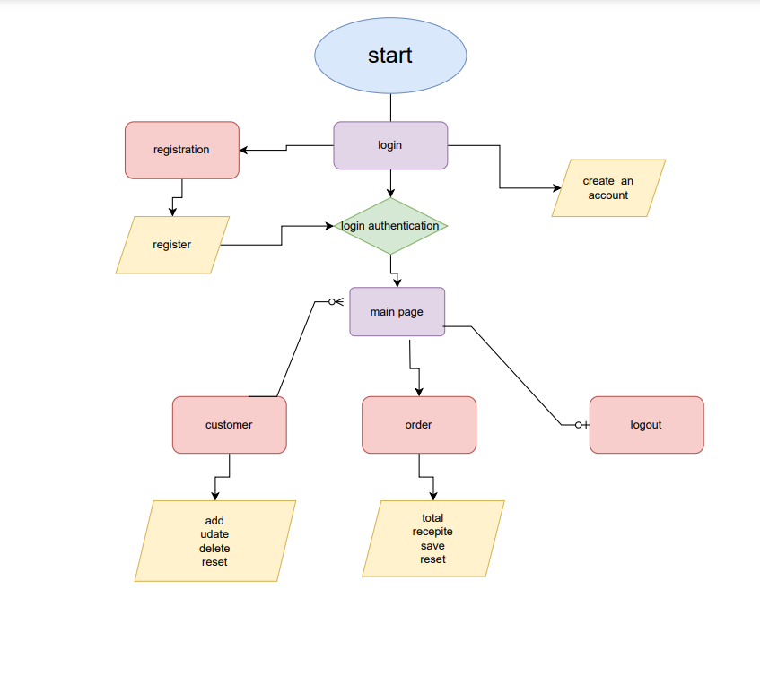
FLOWCHART

Slide 13
WORKING
First the user has to register through the registration page
Then the user has to login using his user id and password
Then he will be directed to the main page
The main page consists of customer details , order , logout buttons
In customer window the details of customer will be added .The details of customer can be retrieved using the customer id or customer mobile no
In Order window we can opt for the desired item and we can specify its quantity
On the right hand side we can generate the bill according to our order and can save in the system
The last button is of logout with the help of which we are directed back to the login page and we exist the main page

Slide 14
REQUIREMENT
OS platform : Windows 7 or above.
Front end : python GUI.
Back end : python.
Compiler : pycharm.
Browser : Google Chrome or any supported browser

Slide 15
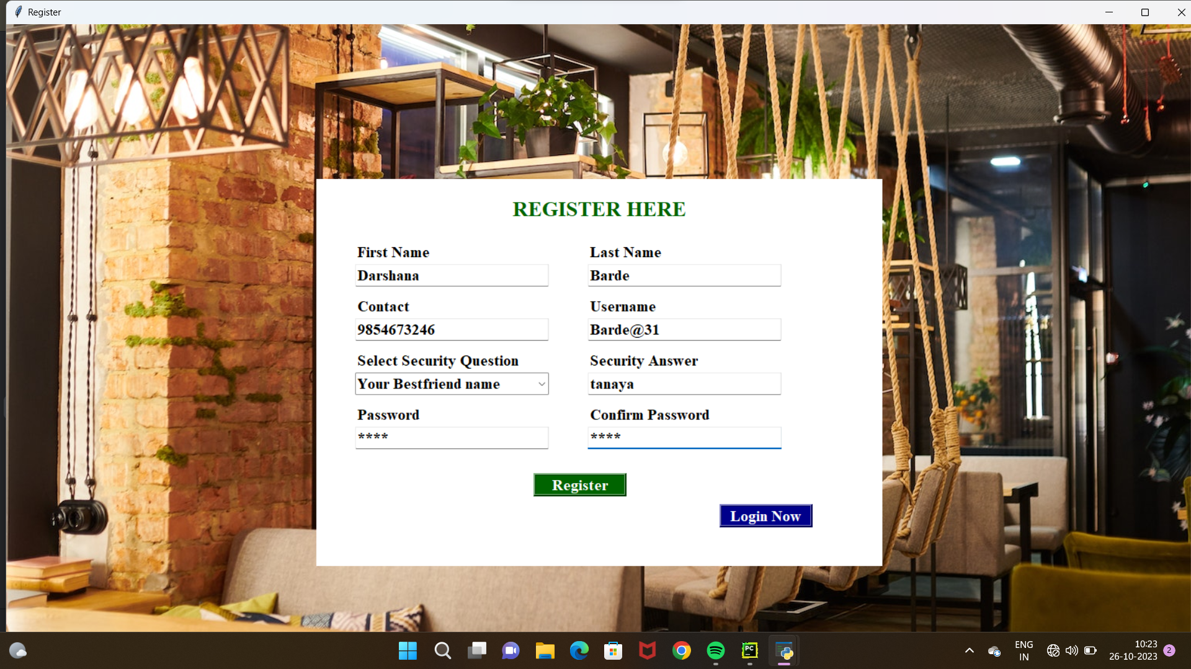
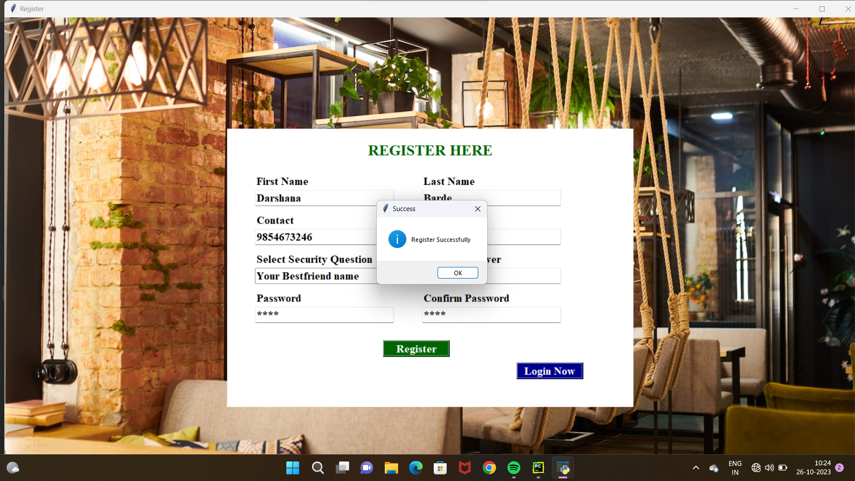
RESULT

Slide 16
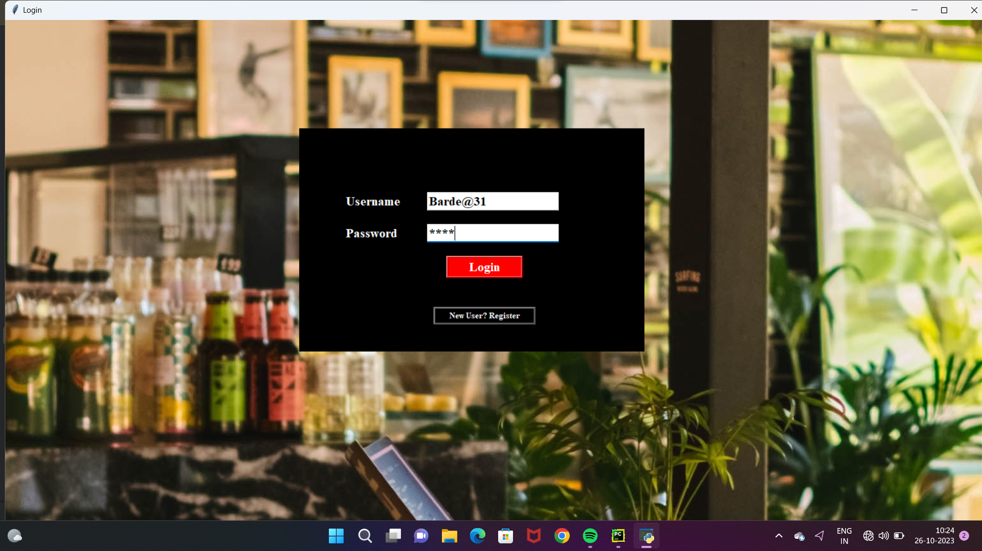
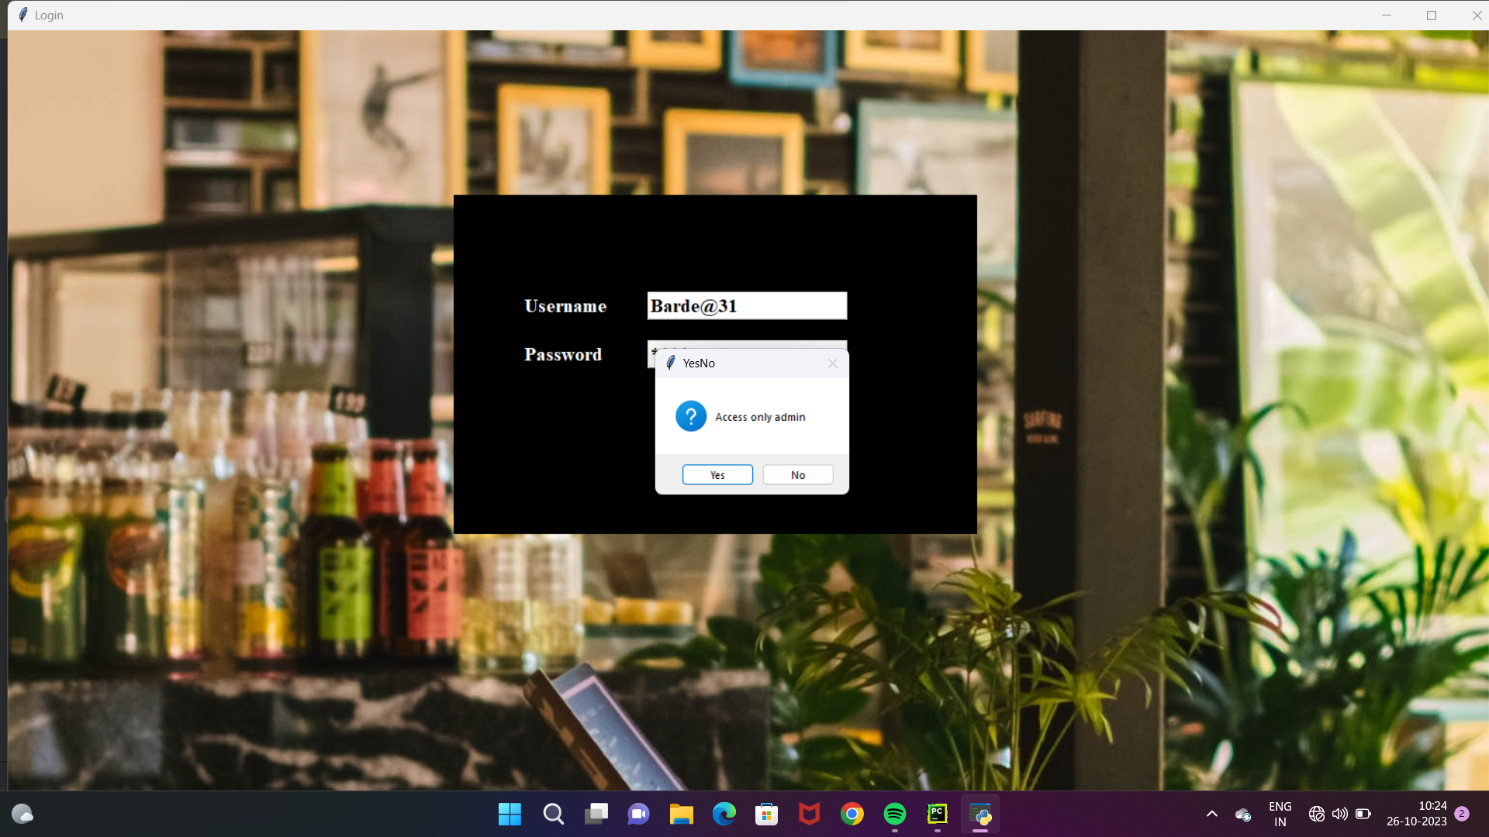
RESULT

Slide 17
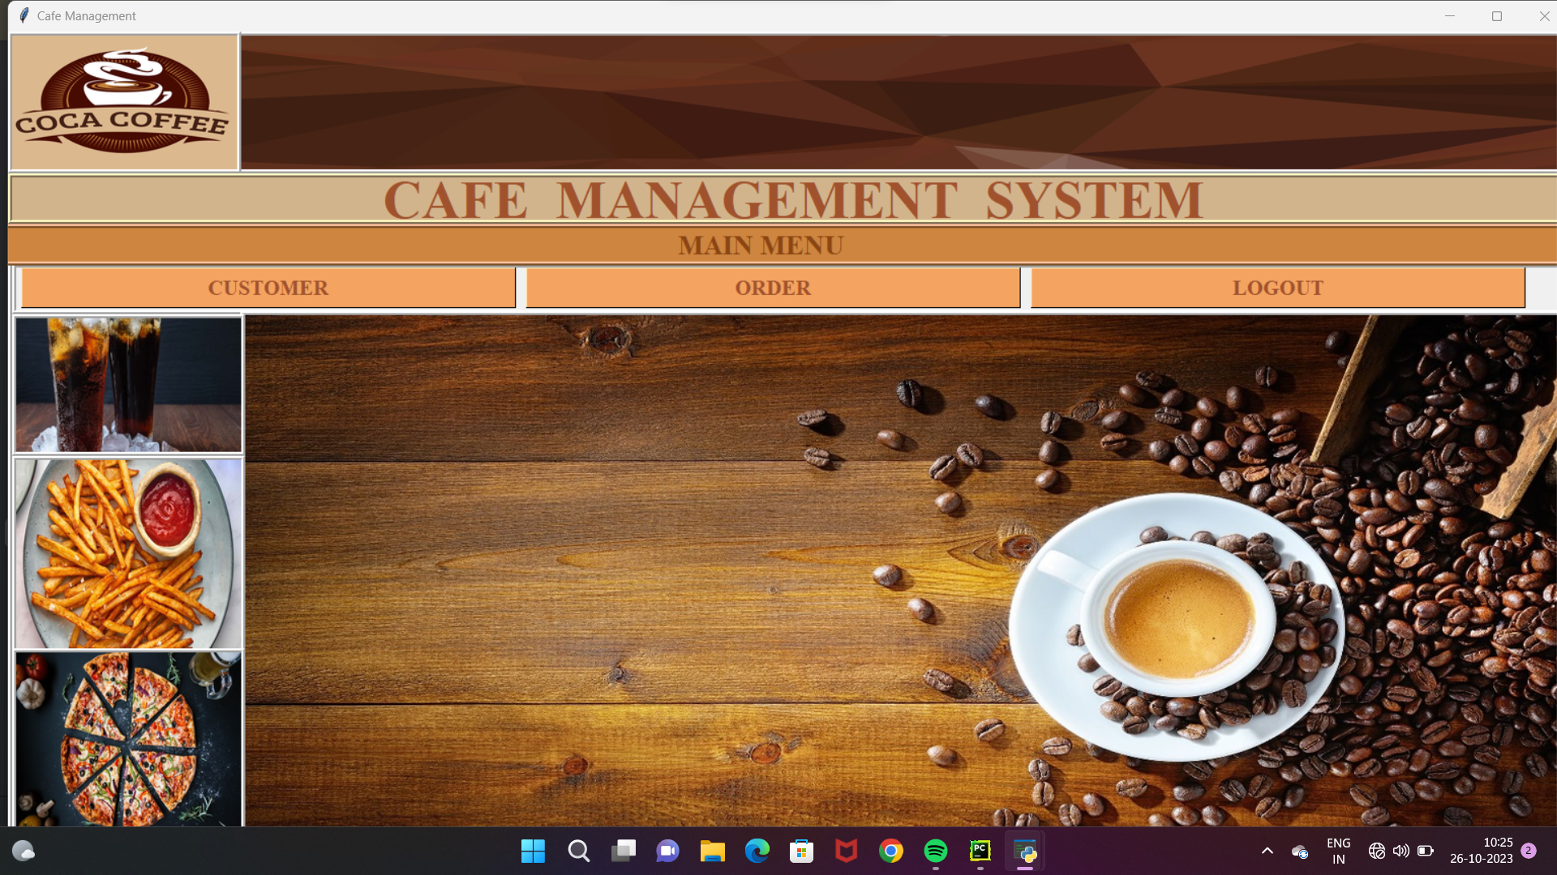
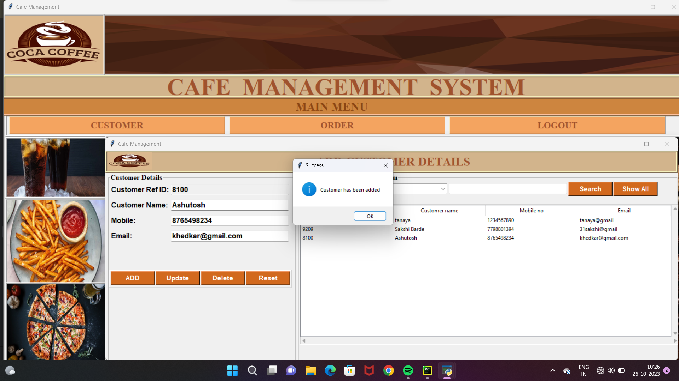
RESULT

Slide 18
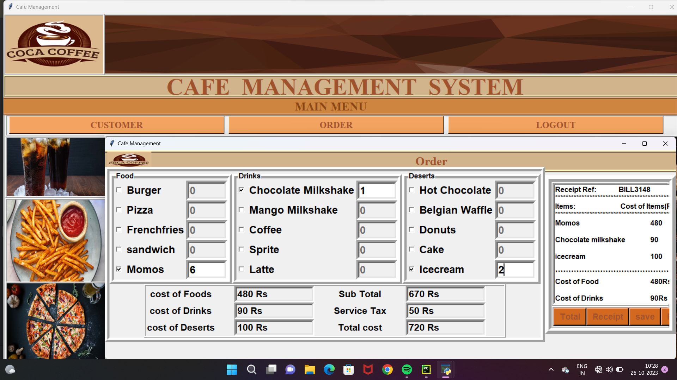
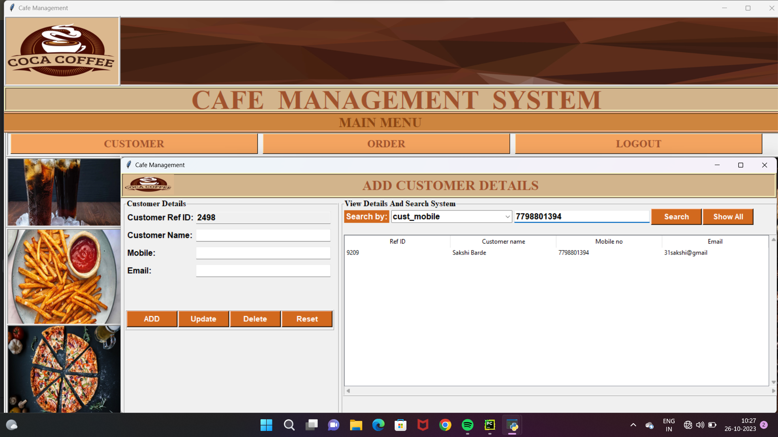
RESULT

Slide 19
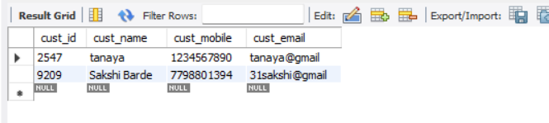
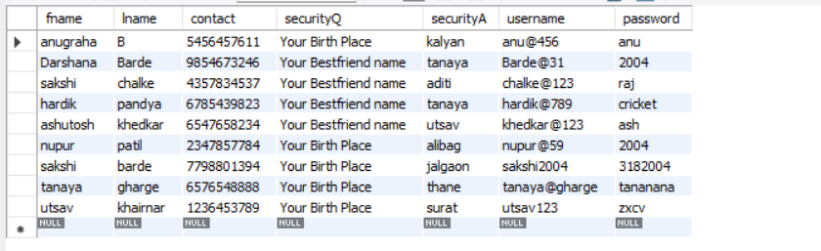

Slide 20
FUTURE WORKS
For future work the following features are to be added.
Online System.
Adding multiple databases which can be accessed from any location in real time
And many more

Slide 21
REFERENCE
https://stackoverflow.com/
https://www.javatpoint.com/

Slide 22
CONCLUSION
Thus we have successfully developed a system used for managing a cafe to keep a track of the customers details and to manage the data systematically

Slide 23
thank you

